Slide 1


GOJAN SCHOOL OF BUSINESS AND TECHNOLOGY
EDAPALAYAM, REDHILLS, CHENNAI-52.
Approved by A.I.C.T.E, New Delhi, Affiliated to Anna University, Chennai. (NAAC Accredited& An ISO 9001:2015 Certified Institution)
DEPARTMENT OF COMPUTER SCIENCE AND ENGINEERING
Project Title: Secure Web Hosting with HTTPS on Microsoft Azure
BATCH - 4
BATCH MEMBERS
SURESH KUMAR.D (110521104049)
VIMALESH.C (110520106303)
YOGESH BALAJI.K (110520106303)
UNDER THE GUIDANCE
Mrs LAVANYA.T ( AP/CSE)
RAMA KRISHNAN.A (110520106303)

Slide 2
ABSTRACT
In the digital era, securing web applications is crucial to protect sensitive data and ensure user trust. Microsoft Azure provides a robust cloud platform for hosting web applications with built-in security features. One of the key aspects of secure hosting is enabling HTTPS, which encrypts data transmission and prevents cyber threats like man-in-the-middle attacks.
Azure makes it easy to secure web hosting by integrating HTTPS with SSL/TLS certificates. Users can configure free SSL certificates using Azure App Service Managed Certificates or upload custom certificates for enhanced security. Azure Front Door and Application Gateway further strengthen security by providing global load balancing, Web Application Firewall (WAF), and DDoS protection.
By leveraging Azure’s security features, businesses can ensure a safe and reliable web hosting environment. Automated certificate renewal, compliance with industry standards, and seamless integration with DevOps pipelines make Azure a preferred choice for secure web hosting. Implementing HTTPS not only improves security but also boosts SEO rankings and user confidence.
2

Slide 3
INTRODUCTION
BACKGROUND OF THE PROBLEM
In the digital age, securing web applications is a critical challenge due to increasing cyber threats like data breaches, phishing, and man-in-the-middle attacks. Traditional hosting solutions often lack built-in security measures, exposing applications to vulnerabilities.
MOTIVATION OF THE PROJECT
With the rise of cloud computing, businesses are shifting towards platforms like Microsoft Azure for scalability, reliability, and security. HTTPS (SSL/TLS encryption) is essential for data protection, SEO ranking, and user trust.
OBJECTIVES AND SCOPES
Enable HTTPS for secure data transmission on Azure.
Implement SSL/TLS certificates (Azure App Service Managed Certificates or custom SSL).
Utilize Azure security services (Web Application Firewall, DDoS Protection).
Ensure automated certificate renewal for seamless security.
Scope includes web hosting setup, security configurations, and performance optimization.

Slide 4
LITERATURE SURVEY
EXISTING RESEARCH/WORK
Many studies emphasize the importance of HTTPS for securing web traffic.
Traditional hosting solutions require manual SSL certificate setup and complex security configurations.
Cloud providers like AWS, GCP, and Azure offer built-in security services and lot of steps.
LIMITATION OF CURRENT SOLUTIONS
Manual SSL management is time-consuming and prone to errors.
Many small businesses do not enable HTTPS due to complexity and cost.
Existing methods lack automation and integrated security at the cloud level.
IMPROVEMENT OF OUR PROJECT
Automates SSL certificate management using Azure Managed Certificates.
Enhances security with Azure Web Application Firewall (WAF) and DDoS protection.
Reduces complexity by providing a step-by-step deployment strategy.

Slide 5
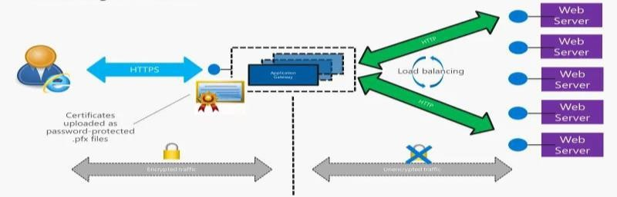
PROPOSED SYSTEM
PROPOSED SYSTEM ARHITECTURE
KEY TECHNOLOGIES USED
Microsoft Azure App Service (for web hosting)
Azure Managed Certificates (for free HTTPS setup)
Azure Front Door & Application Gateway (for security & traffic management)
Azure Web Application Firewall (WAF) (for protection against cyber attacks)
EXPECTED BENEFITS
Enhanced security through end-to-end encryption.
Easy HTTPS setup with automatic certificate renewal.
Better performance with load balancing and DDoS protection.

Slide 6
METHODOLOGY
MODULES AND FUNCTIONALITIES
Web Hosting Module – Deploy web apps on Azure App Service.
SSL/TLS Setup Module – Configure Azure Managed Certificates for HTTPS.
Security Module – Implement Azure WAF and DDoS Protection.
Monitoring & Maintenance Module – Automate certificate renewal and security audits.
IMPLEMENTATIONS
Deploy a web application on Azure App Service.
Enable HTTPS using Azure Managed Certificates.
Integrate Azure WAF for attack prevention.
Configure Azure Front Door for load balancing.
Automate SSL renewal to maintain security.
Monitor security logs and optimize performance.

Slide 7
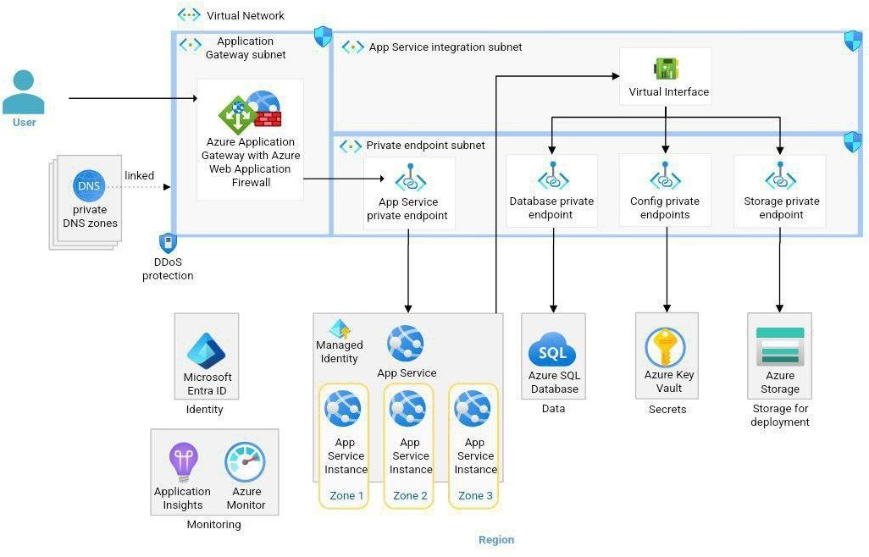
ARCHITECTURE DIAGRAM

Slide 8
CHALLENGES & FUTURE PLANS
CURRENT CHALLENGES
Certificate propagation delay when enabling HTTPS for the first time.
Cost vs. performance trade-off in using Azure Front Door for global content delivery.
Integrating additional security layers (like firewalls & intrusion detection) without latency impact.
FUTURE PLANS
Fine-tune SSL/TLS settings for faster HTTPS setup and compatibility checks.
Optimize Azure security features like WAF and DDoS protection for maximum security.
Conduct performance testing, finalize deployment, and document best practices.

Slide 9
CONCLUSION
SUMMARY
Deploy a secure web application with HTTPS enabled.
Automate SSL/TLS setup which it reducing manual configuration efforts.
Enhance security using Azure security tools (WAF, DDoS protection, and traffic encryption).
EXPECTED IMPACTS
Ensures data security & user trust with encrypted communication.
Simplifies HTTPS adoption with automated certificate management.
Improves website ranking (SEO boost) and compliance with industry security standards.
9

Slide 10
REFERENCES
T. Sheela, V. Kalya, T. Bhavya, and T. Harshitha, “Secure Online Examination System on Azure Cloud with Load Balancer,” 2021 4th International Conference on Computing and Communications Technologies (ICCCT), 2021, pp. 170–174. IEEE Xplore
T. Benjapanplotak, M. Karakate, and K. Sripanidkulchai, “Enabling Live Migration of Containerized Applications Across Clouds,” IEEE INFOCOM 2020 - IEEE Conference on Computer Communications, 2020, pp. 1952–1961. IEEE Xplore
Q. Jacquemart, C. Pigout, and G. Urvoy-Keller, “Inferring the Deployment of Top Domains over Public Clouds using DNS Data,” 2019 Network Traffic Measurement and Analysis Conference (TMA), 2019, pp. 67–72. IEEE Xplore
N. Mangla, J. Singh, and M. Singh, “Improving Performance of Web Applications Using Cloud
Resources,” 2014 International Conference on Reliability Optimization and Information Technology
(ICROIT), 2014, pp. 267–270. IEEE Xplore

Slide 11
THANK YOU

